Slide 1

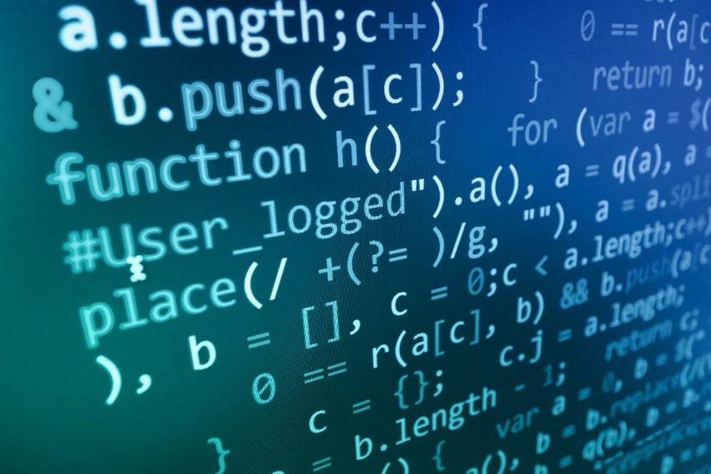
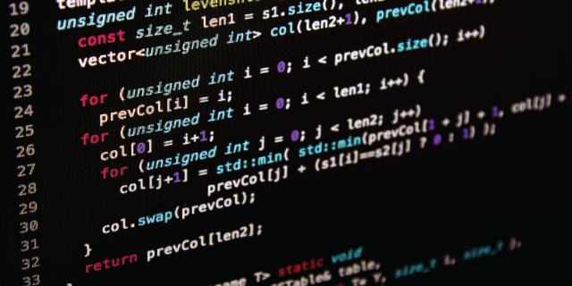
Basics of Algorithmization and Program
Prepared & Presented by: Mirlan Nurbekov, Lecturer
Office hours: Friday 9:00–17:00
AlaToo IT & Business College
Fall 2025

Slide 2






JAVA
Revision: from basics to advanced

Slide 3
IMPORTANT
All tasks and solutions presented in this course are meant to be actively practiced.
Students are highly encouraged to experiment, improve, and build upon the provided solutions.
Learning is best achieved through hands-on practice, curiosity, and creativity…
Your Instructor,
Mirlan Nurbekov

Slide 4
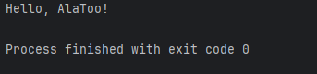
Task - 0000
0000 - Hello World – Print “Hello, AlaToo!”

Slide 5
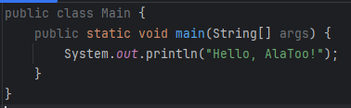

Slide 6
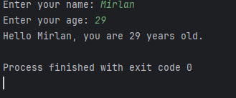
Task - 0001
0001 - User Input – Ask for name and age, then print them back.

Slide 7
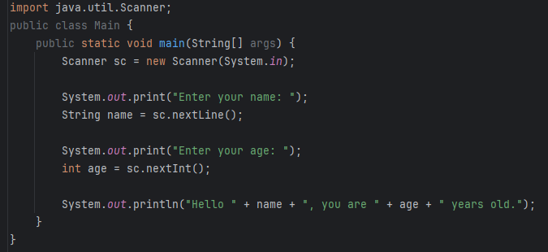

Slide 8
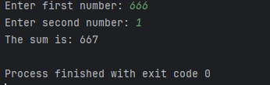
Task - 0002
0002 - Simple Calculator – Input two numbers, print sum.

Slide 9
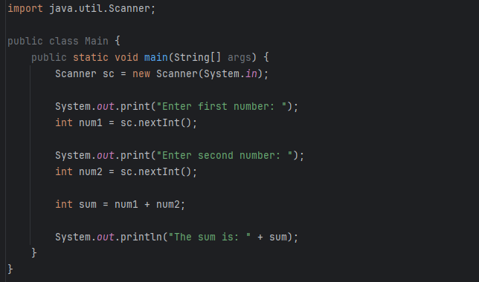

Slide 10
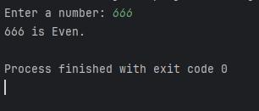
Task - 0003
0003 - Even or Odd – Check if a number is even or odd.

Slide 11
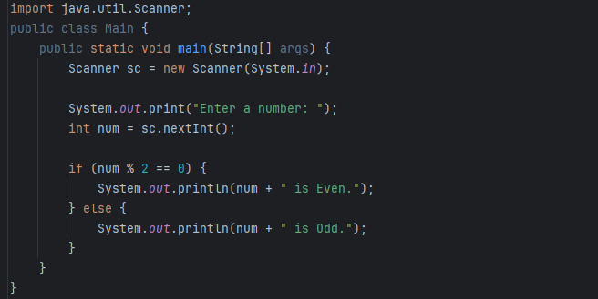

Slide 12
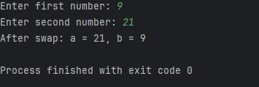
Task - 0004
0004 - No cane - Swap 2 numbers without 3rd variable (no temp variable)

Slide 13
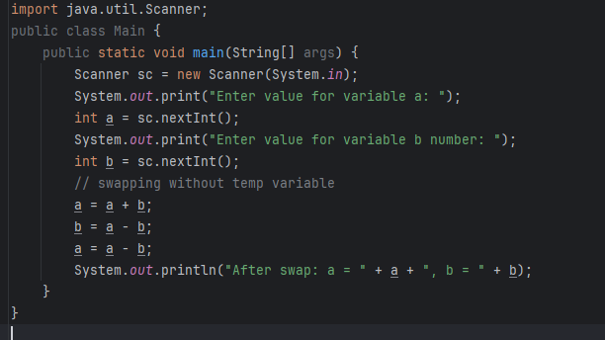

Slide 14
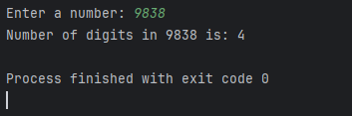
Task - 0005
0005 - Digit counter - count digits in a number (how many digits are in a given integer)

Slide 15
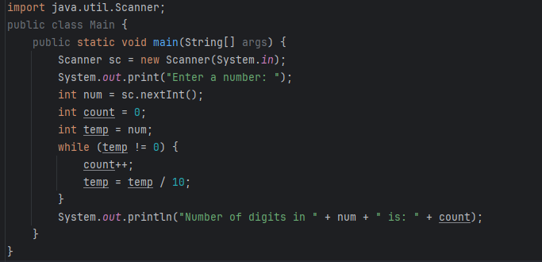

Slide 16
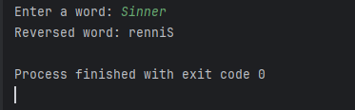
Task - 0006
0006 - Reverse a String - take a word as input and prints it reversed.

Slide 17
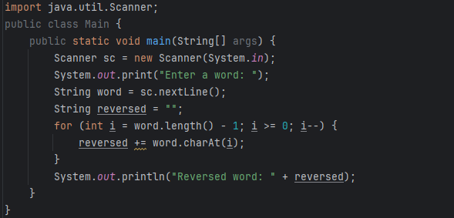

Slide 18
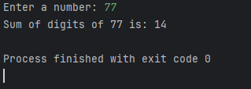
Task - 0007
0007 - Sum of Digits - find the sum of digits of a given number

Slide 19
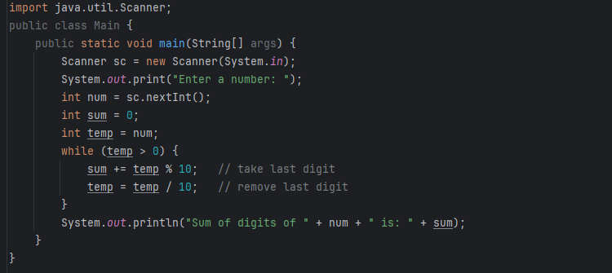

Slide 20
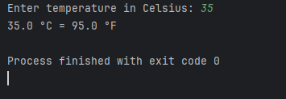
Task - 0008
0008 - Temperature Converter - convert temperature from Celsius to Fahrenheit.

Slide 21
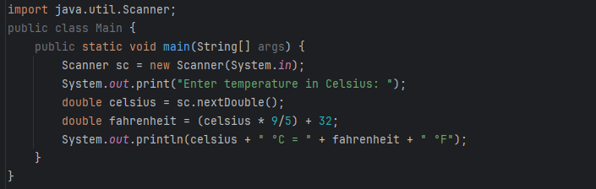

Slide 22
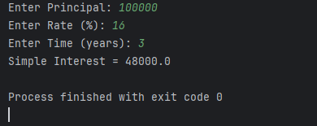
Task - 0009
0009 - Interest Calculator - use SI = (Principal × Rate × Time) / 100

Slide 23
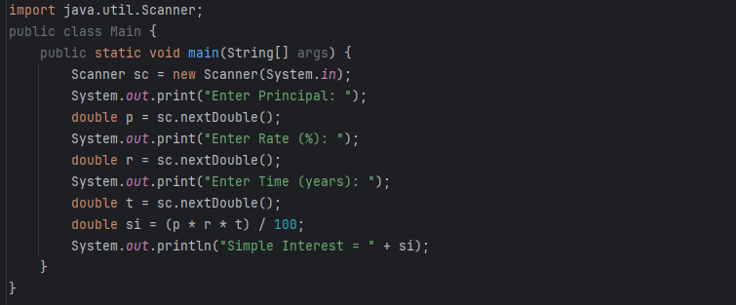

Slide 24
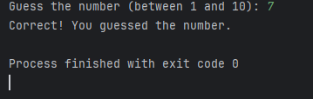
Task - 00010
0010 - Number Guessing - computer has a fixed secret number, and the user tries to guess it.

Slide 25
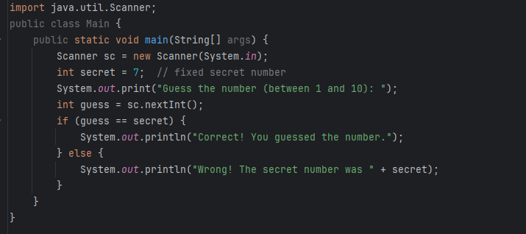

Slide 26
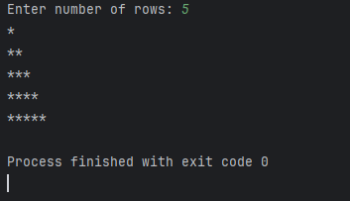
Task - 0011
0011 - Triangle Pattern - prints a right-angled triangle of stars.

Slide 27
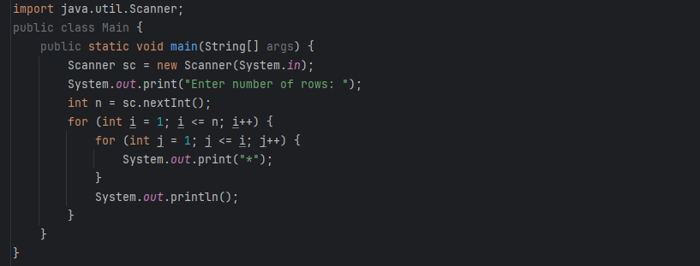

Slide 28
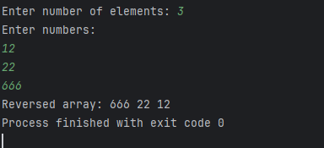
Task - 0012
0012 - Reverse an Array - takes n numbers into an array and prints the array in reverse order.

Slide 29
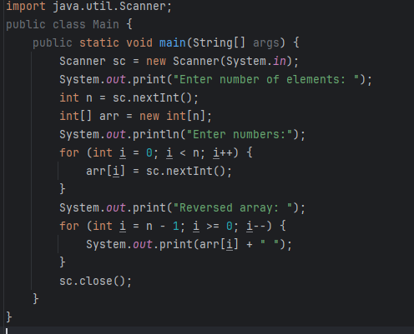

Slide 30
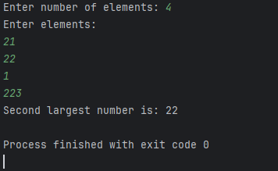
Task - 0013
0013 - Find Second Largest Number in Array

Slide 31
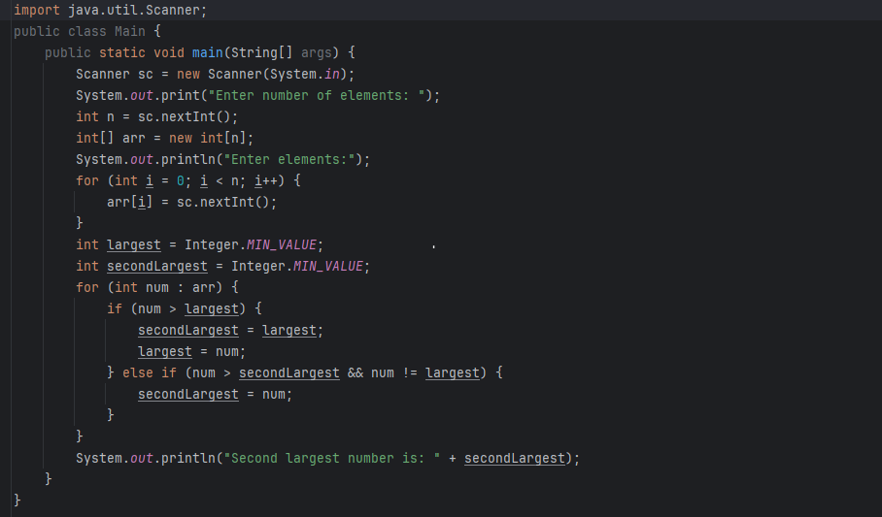

Slide 32
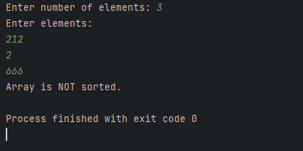
Task - 0014
0014 - Check if Array is Sorted - check whether an array of numbers is sorted in ascending order

Slide 33
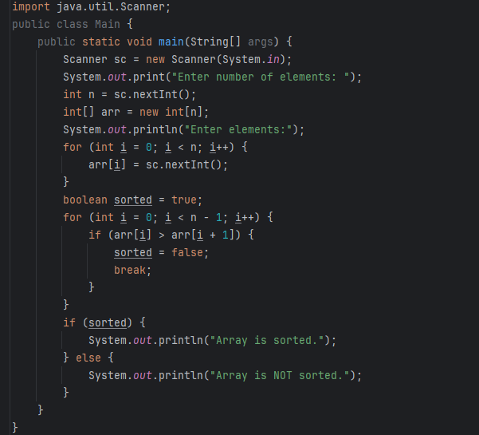

Slide 34
Task - 0014 - detailed
Algorithm involved: Linear search / traversal algorithm for order checking. Iterative traversal (a simple O(n) algorithm). It introduces logical decision-making and loop-based checking — core elements of algorithmic thinking.

Slide 35
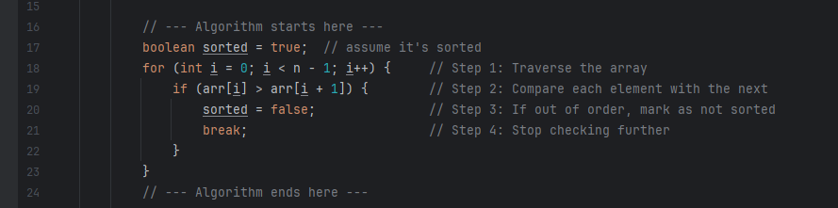
Task - 0014 - detailed

Slide 36
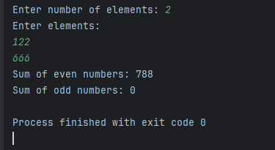
Task - 0015
0015 - Sum of Even and Odd Numbers in Array - calculates the sum of even numbers and the sum of odd numbers in an array

Slide 37
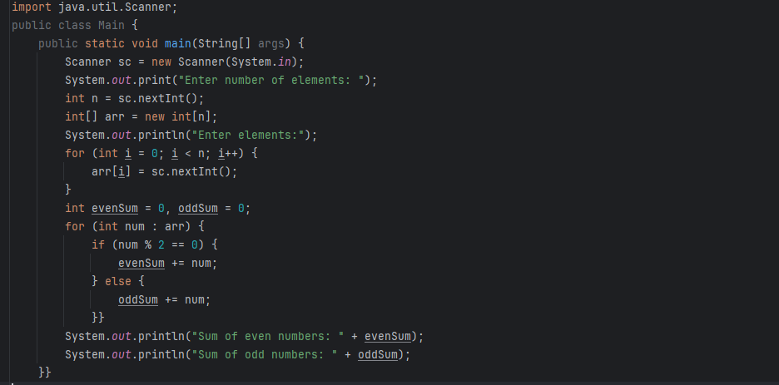

Slide 38
Task - 0015 - detailed
Algorithm: Categorization and Accumulation
This program uses a simple linear traversal algorithm to go through all elements in the array and separate numbers into two categories — even and odd — while accumulating their sums.

Slide 39
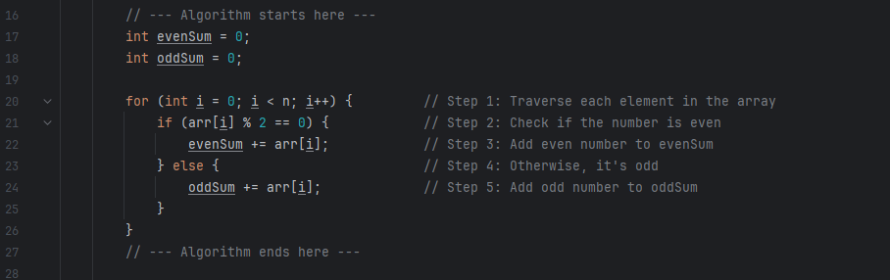
Task - 0015 - detailed

Slide 40
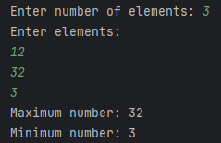
Task - 0016
0016 - Write a program that reads n integers from the user, stores them in an array, and finds both the maximum (largest) and minimum (smallest) numbers. Your program should: ask the user to enter how many elements (n) they want to input tnen read n integers and store them in an array.Compare each element to find the largest and smallest numbers.Display the maximum and minimum values at the end.

Slide 41
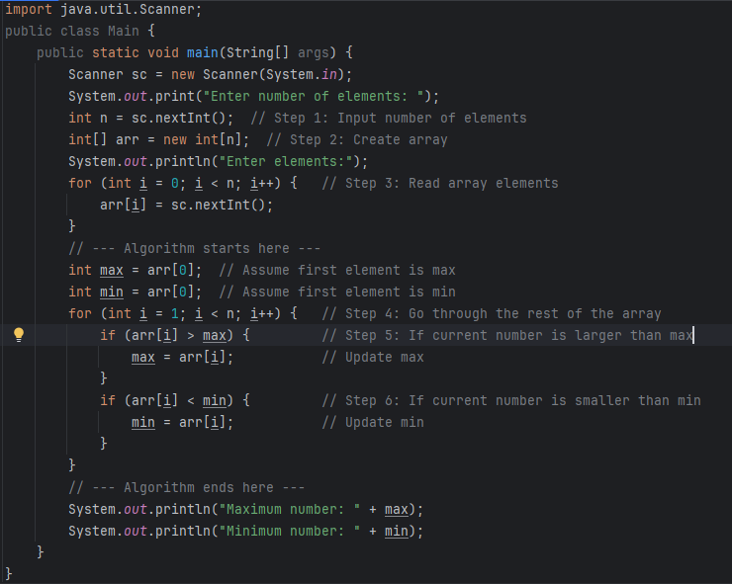

Slide 42
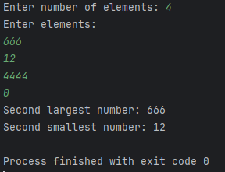
Task - 0017
0017 - Write a program that reads n integers from the user, stores them in an array, and finds both the second largest (second maximum) and second smallest (second minimum) numbers.

Slide 43
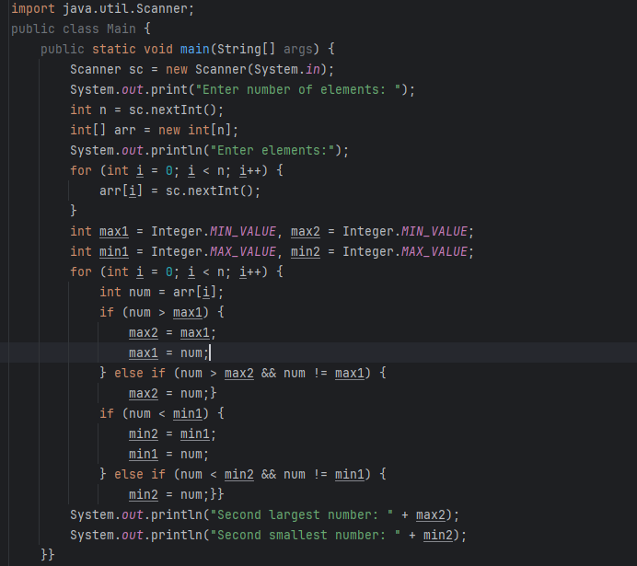

Slide 44
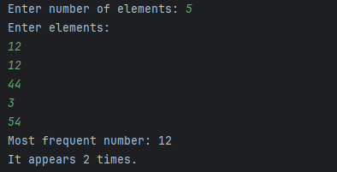
Task - 0018
0018 - Write a program that reads n integers from the user, stores them in an array, and finds the number that appears most frequently — also known as the mode. If more than one number has the same highest frequency, the program should display the larger number.

Slide 45
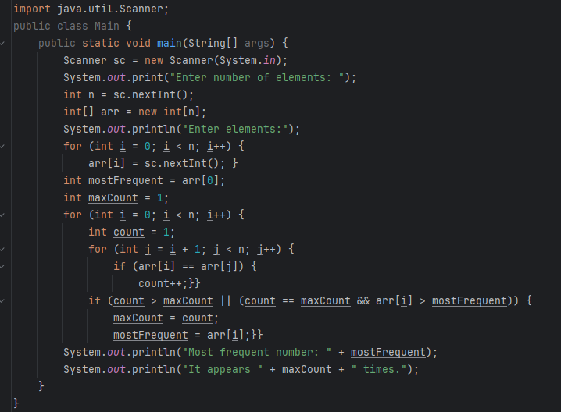

Slide 46
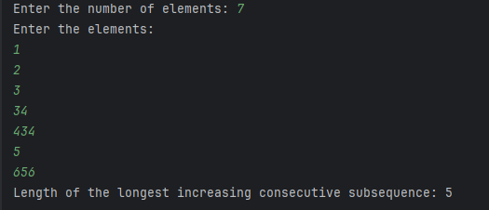
Task - 0019
0019 - Write a program that reads n integers from the user, stores them in an array, and determines the length of the longest increasing consecutive subsequence in the array. A consecutive subsequence means numbers that follow each other in the array and increase one after another.

Slide 47
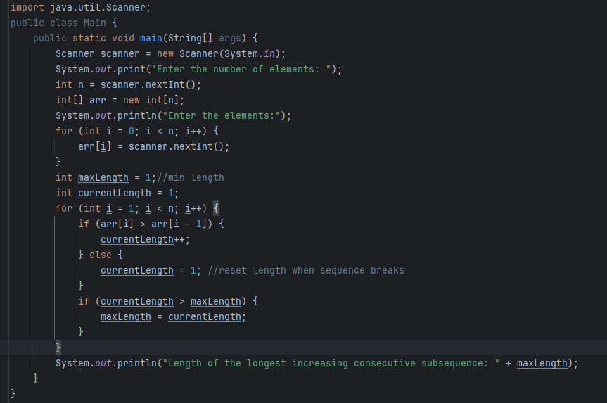

Slide 48
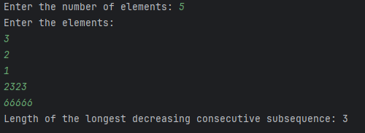
Task - 0020
0020 - Write a Java program that reads n integers from the user, stores them in an array, and determines the length of the longest decreasing consecutive subsequence in the array.

Slide 49
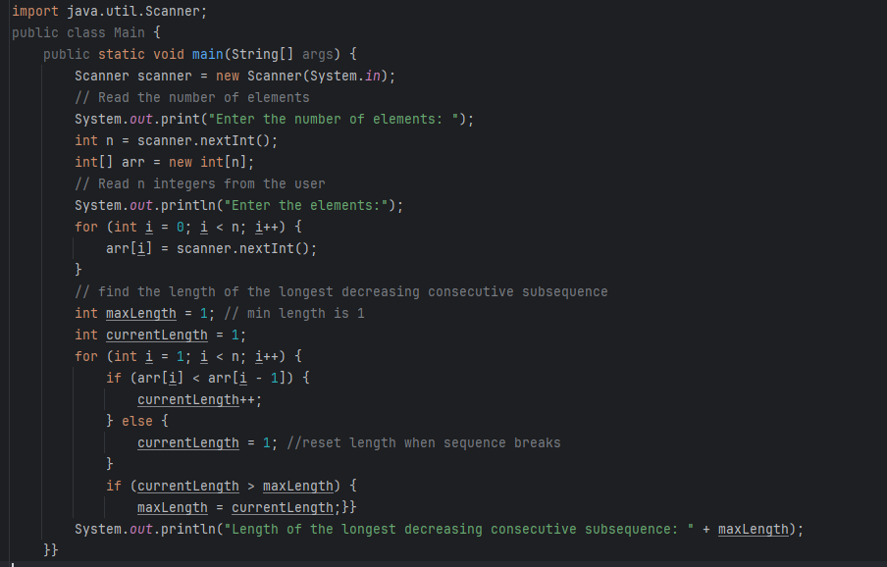

Slide 50
Task - 0021
0021 - Write a Java program that reads 10 integers from the user, stores them in an array, and checks if there is any arithmetic or geometric pattern among them.
Arithmetic sequence is when each number differs from the previous by the same amount.
Geometric sequence, when each number is multiplied by the same factor to get the next number.

Slide 51
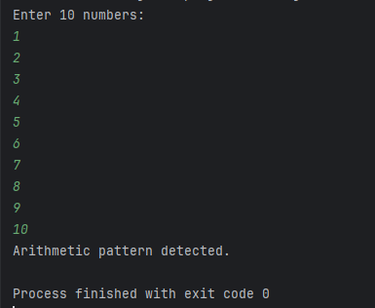
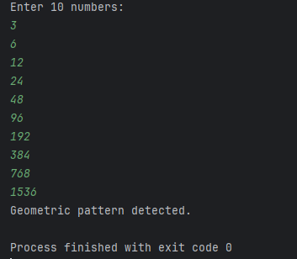
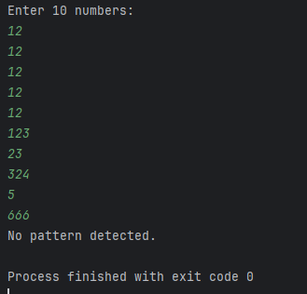

Slide 52
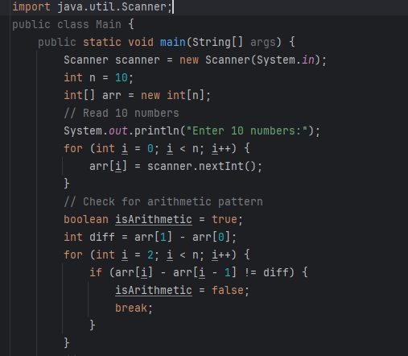

Slide 53


